Slide 1

Version Control for Highschoolers
Tamoor Shahid

Slide 2
Who am I?
My name is Tamoor.
Final year of studying Computer Science at The University of Manchester.
Final Year Project on teaching version control systems.

Slide 3
What is Version Control?
Version control is the idea of tracking minor and major changes made to a project. In Computer Science, version control is a system that manages and keeps track your files.

Slide 4
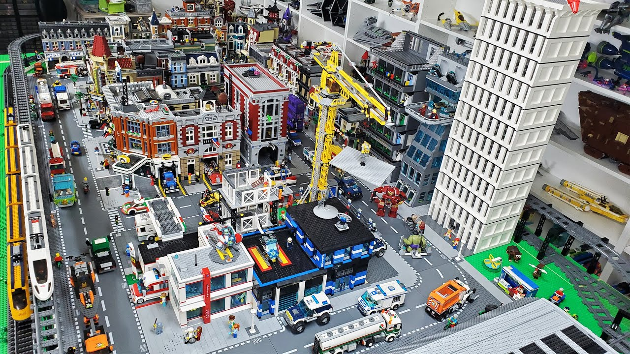
What is Version Control?

Slide 5
What is Version Control?
Imagine that you and your friends are going to make a city out of Lego and you only have a week.
What are some things to consider in your approach to this project?

Slide 6
What is Version Control?
Splitting tasks up into smaller tasks
Collaboration
Experimentation
Keeping track of changes
Backups
Iteration

Slide 7
Splitting and Collaboration
A Lego city is a massive project so you will want to split it up into smaller tasks.
Why would you want to collaborate together?
How would you split it up? Why did you choose to split it up like that?
How will you decide who should do what?

Slide 8
Changes and Backups
How could you keep track of changes to your Lego city as you build it?
What are some potential problems that could arise if you don't keep track of changes or make backups?
What could you do to protect your city?
How can you make backups in case something goes wrong?

Slide 9
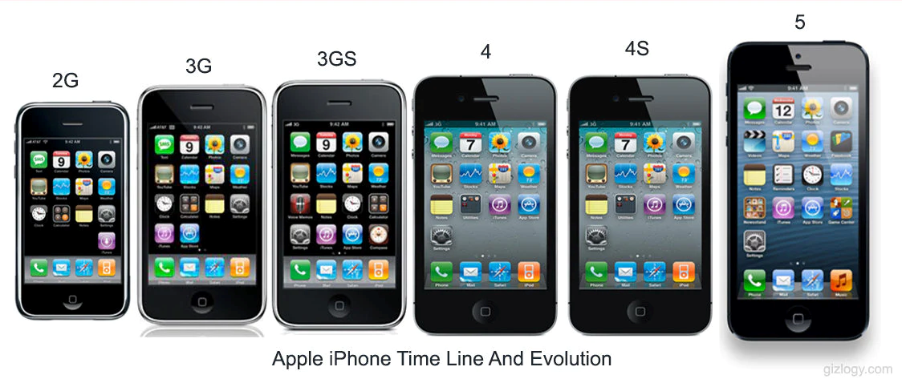
Iteration
Iteration is the process of making small changes and improvements to something over time.

Slide 10
Iteration
The first iPhone (or 2G) was the creation of the smartphone. It was the first iteration of the smartphone.

Slide 11
Iteration
The second iPhone, the iPhone 3G, was created when Apple returned to the first iPhone and figured out what to change.
They added:
The App store
GPS navigation
A bigger screen

Slide 12
Iteration
After they released the iPhone 3G, they examined the iPhone again and reiterated on its features once more.
They added:
Copy and Paste
Voice Control
An in-built compass

Slide 13
Iteration
They didn’t just add stuff though when they iterate, they also removed or changed existing features too.
Such as the:
Headphone jack
Physical home button
Phone casing

Slide 14
Experimentation and Iteration
Iteration is the process of making small changes and improvements to something over time.
What does it mean to experiment with your Lego city?
How could you use iteration to improve your Lego city over time?
Why is it important to be open to trying new things and making changes as you build your Lego city?

Slide 15
Why should YOU learn Version Control?
Version control is an essential tool used in every software development project. There are very few computer science jobs that won’t require you some form of version control knowledge.

Slide 16

Why should YOU learn Version Control?
It allows teams of programmers to collaborate efficiently and effectively, whether it be one company or all over the world.
Open-source projects use version
control systems to allow programmers
all around the world to contribute code
to projects.

Slide 17
Why should YOU learn Version Control?
It allows for easy project management.
You can switch between different projects very easily.
Change versions very easily too, like if you want to access older versions of a video game.
You can also track your progress easily too.

Slide 18
Why should YOU learn Version Control?
Even if you don’t plan on pursuing computer science in the future, it’s still very useful to know.
There are computer scientists in every company and you might need to interface with them.

Slide 19
Why should YOU learn Version Control?
Other jobs that may require version control systems are:
Scientists & Researchers
Data Analysts
Architects and Engineers
Technical Writers
Project managers and more

Slide 20
Why should YOU learn Version Control?
Jobs that may require version control systems are:
Researchers
  Research data is often irreplaceable so backing it up is extremely important.
  Knowing version control can make it easier for researchers to access programs made by developers for their research needs.
  A history of changes made can help make results reproducible.
  It also lets others access your code to make sure your work is ethical.

Slide 21

Git
We’ll be learning to use Git in these lessons. There are many reasons why:
World’s most used version control system
Completely free
Compatible with most operating systems
It is also the industry standard, most other version control systems are niche or deprecated.

Slide 22

GitHub
Though it works really well with Git, it is not the same thing.
GitHub is just a website.
  It has a very nice user interface.
  Let’s us host our projects in the cloud.
  Allows users to collaborate easily.
Git does all the version control work. You can treat GitHub like an extension. You don’t need to use GitHub to use Git.

Slide 23
Version Naming
As you create your projects, you’ll end up with lots of variations of your project. You’ll need a way to keep track of what variation is what. Especially if you’re going to share your project with other people like customers.
You’ll inevitably have seen some version naming systems of your own, can you name some?

Slide 24
Version Naming
Though you can name it however you want, there are four common choices.
Number
Date
Semantic
Milestone

Slide 25
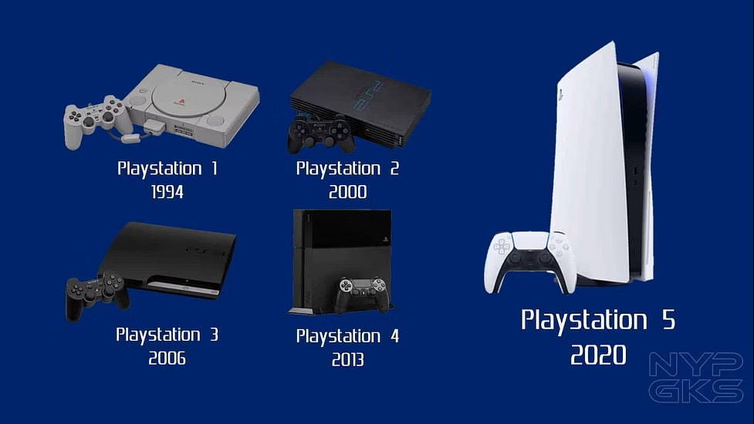
Version Naming - Number
Number is the most simple one. You just name it based on the iteration.
For example, the PlayStation.

Slide 26

Version Naming - Date
Date is quite self-explanatory. You use the date you release the version as the name.
One example is Microsoft Office. They use the year to distinguish their products from the previous ones.

Slide 27
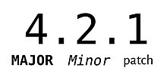
Version Naming - Semantic
Semantic uses 3 numbers to determine version type:
Major Release – Signifies very major changes to the software.
Minor Release – Signifies new features or big but not major changes
Patch – Bug fixes or other small updates to the software

Slide 28
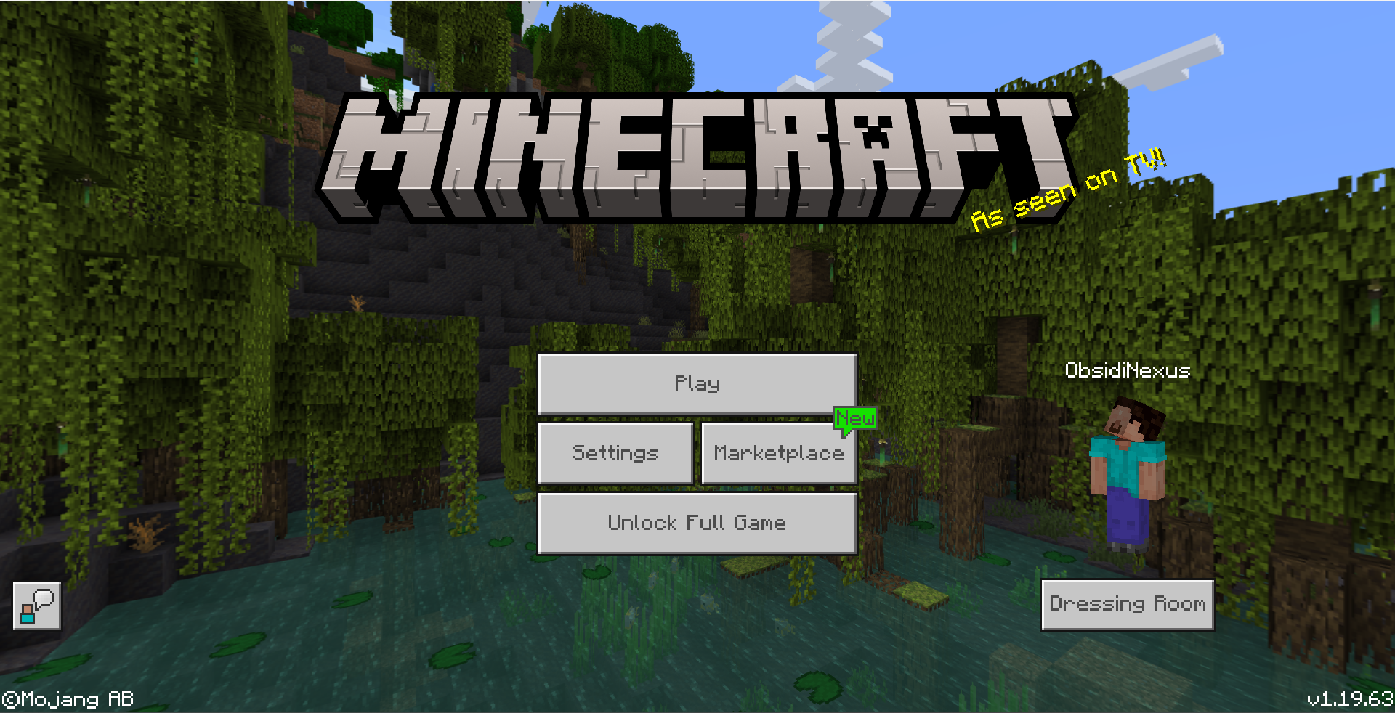
Version Naming - Semantic
Major
1
Minor
19
Patch
63

Slide 29
Version Naming - Milestone
Milestones refer to the major releases of a software. The most common ones are Alpha, Beta and Release.
Alpha is a very early version for testing and development. Usually no one besides the developers see it.
Beta is when the software is more polished and is often tested by a wider audience.
Release is when the bugs are fixed and the software is ready to be released.

Slide 30
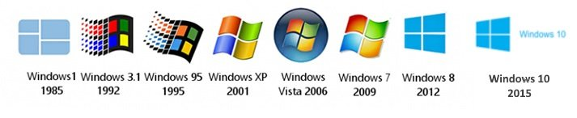
Version Control - Random
If you look at one version, you can’t correctly tell what the previous versions were. It’s usually done for marketing reasons.
Microsoft Windows has a random naming system. Windows 7 and 8 would imply that the next one would be Windows 9, but it was 10 instead.

Slide 31
Common Git Terminology
Important words to know:
Repository – This refers to the place you store your project files and your version history. It’s like a giant folder.
Commit – A commit is like taking a snapshot of your work at a particular point in time. It records the changes you’ve made and you can add a small message to explain what the changes were.
Branch – A separate version of the same project. If you work on this, it won’t affect the main version of the project.

Slide 32
NEXT…
Now you should have a basic understanding of version control.
Fill out the feedback form in front of you.
  Remove this later but the feedback form is to get information on how students found the powerpoint and what they felt was useful and not useful etc so I can put it in my report.
Go to your computers and access [URL]
If you have any questions, feel free to ask me.

Slide 33
Helpful Videos
Fireship - https://www.youtube.com/watch?v=HkdAHXoRtos
Tech with Tim - https://www.youtube.com/watch?v=DVRQoVRzMIY
Software Versioning Explained - https://www.youtube.com/watch?v=xvPiZyx0cDc

